Slide 1
The Data Goldrush – Day 4

Slide 2
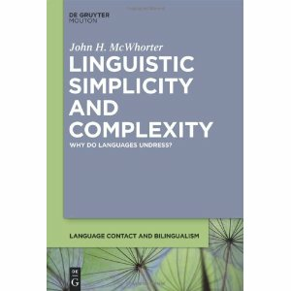
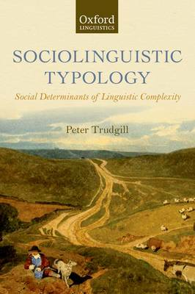
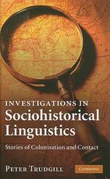
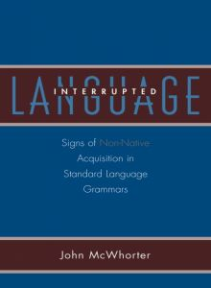
Social structure and language structure
John McWhorter
Peter Trudgill

Slide 3
The “Linguistic Niche Hypothesis” (Lupyan & Dale, 2010)
Esoteric Languages
Exoteric Languages
‘inward adapted’
‘outward adapted’
Thurston, W.R. (1987). Processes of change in the languages of north-western New Britain. In: Pacific Linguistics B99, The Australian National University, Canberra.
Thurston, W.R. (1989). How exoteric languages build a lexicon: esoterogeny in West New Britain. In R. Harlow, & R. Hooper (Eds.), VICAL 1: Oceanic Languages. Papers from the Fifth International Conference on Austronesian Linguistics (pp. 555-579). Auckland: Linguistic Society of New Zealand.
Wray, A., & Grace, G. (2007). The consequences of talking to strangers : Evolutionary corollaries of socio-cultural influences on linguistic form. Lingua, 117, 543–578.
Notes:
one of the guiding idea is that one of the adaptations is morphological structure
esoteric languages, where more meaning becomes expressed in morphologically
that notion is driven by the observation that adults have difficulties learning languages, in particular the morphosyntactic languages
vs. CHILDREN; the balance shifts as to who is doing the learning

Slide 4

Different kinds of language contact
example:
the influence of Slavic on Romanian
McWhorter, J. (2007). Language interrupted: Signs of non-native acquisition in standard language grammars. Oxford: Oxford University Press.

Slide 5
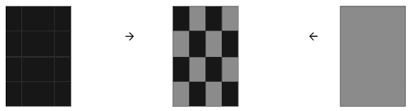
Different kinds of language contact
example:
Media Lengua (Spanish lexicon + Quechua phonology & morphosyntax)
McWhorter, J. (2007). Language interrupted: Signs of non-native acquisition in standard language grammars. Oxford: Oxford University Press.

Slide 6
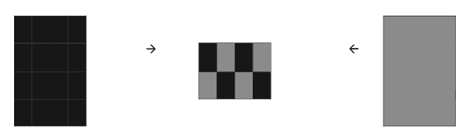
Different kinds of language contact
Creolization
McWhorter, J. (2007). Language interrupted: Signs of non-native acquisition in standard language grammars. Oxford: Oxford University Press.

Slide 7
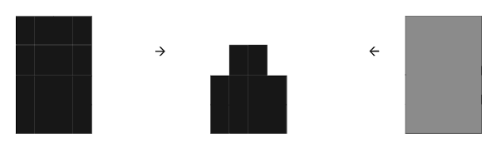
Different kinds of language contact
Simplification
McWhorter, J. (2007). Language interrupted: Signs of non-native acquisition in standard language grammars. Oxford: Oxford University Press.
Notes:
outstanding questions are what are the pathways for these things to happen
they are not mutually exclusive
this is what we are going to talk about today, and we will accumulate this happens
correlational evidence for this and ideas for why this happen

Slide 8
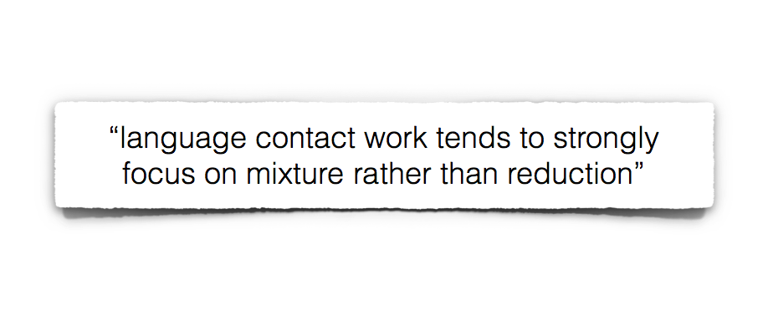
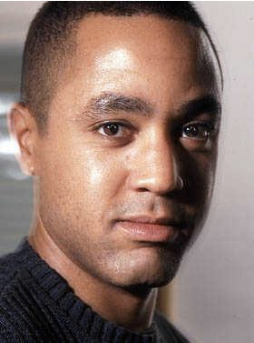
Different kinds of language contact
McWhorter (2007: 4)
John McWhorter
McWhorter, J. (2007). Language interrupted: Signs of non-native acquisition in standard language grammars. Oxford: Oxford University Press.

Slide 9
What might be the source(s) of reduction/simplification?

Slide 10
Language use as information transmission
Information in language is transmitted over a very complex channel:
sounds
words – content plus functional
sentences
gestures
All occurring within a larger, top-down predictive context
discourse information
social information
world information

Slide 11
Language use as information transmission
Given the complexity of the channel and predictive context…
An approximately equivalent rate of information transmission can be achieved many ways.
Lots of indirect evidence that this might be the case.

Slide 12
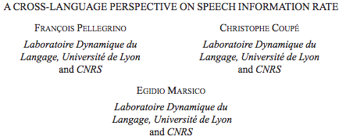
Language (2011), Volume 87, pp. 539-558

Slide 13
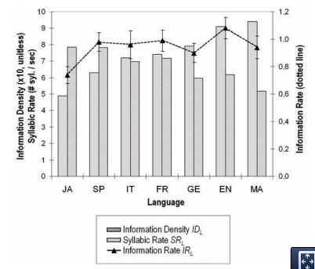
Syllable-rate and information-density inversely correlated

Slide 14
Syntagmatic vs paradigmatic complexity
base 10 vs binary:
2749 = 101010111101
→ Languages with larger phoneme inventories tend to have shorter words (Nettle, 1995, 2008)
→ Words that are less predictable tend to be longer (Zipf 1949, Piantadosi et al. 2010)

Slide 15
Focus today: morpho-syntactic complexity
What factors might influence how much communicative function is allocated to morpho-syntactic features?
Relevant factoid:
Adults are very good at learning new lexical information.
Relative to children, they are crap at learning new morpho-syntactic information

Slide 16
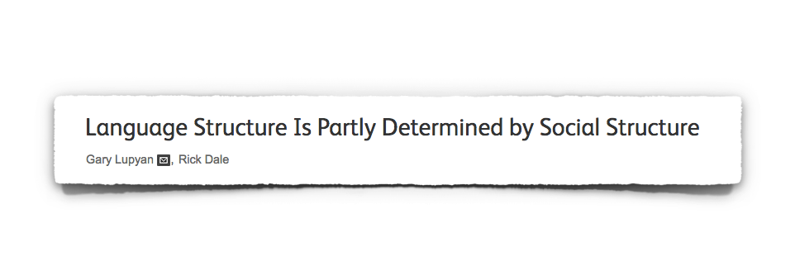


Is contact-induced reduction quantitatively dominant?
Gary Lupyan
Rick Dale
Lupyan, G., & Dale, R. (2010). Language structure is partly determined by social structure.
PloS ONE, 5(1), e8559.

Slide 17
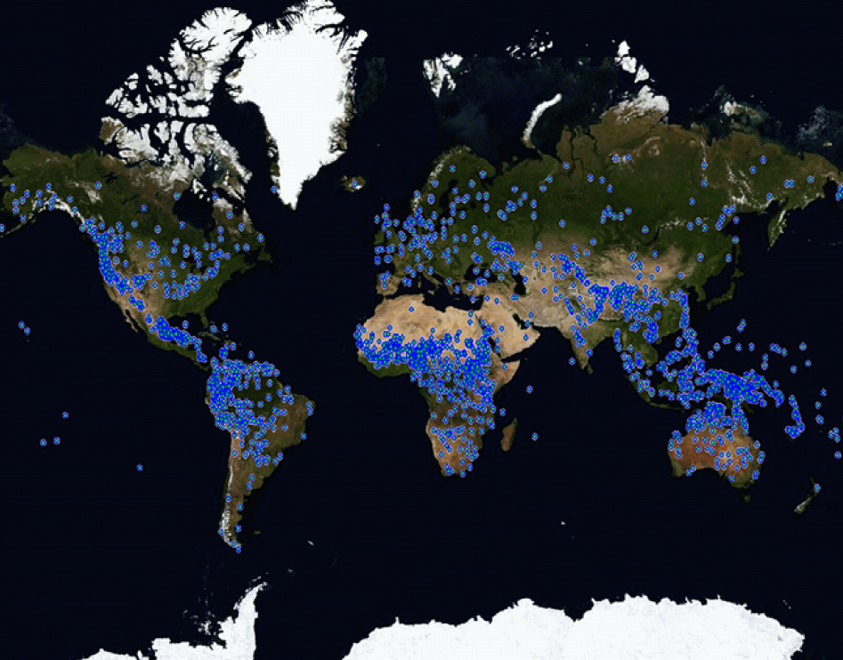
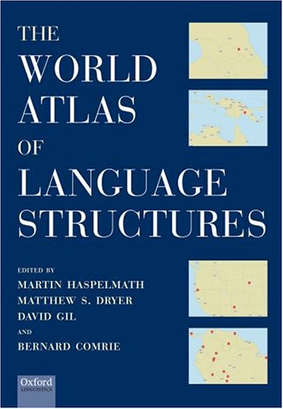
Lupyan & Dale (2010):
Sample
Lupyan, G., & Dale, R. (2010). Language structure is partly determined by social structure.
PloS ONE, 5(1), e8559.

Slide 18

Lupyan & Dale (2010):
Sample
Lupyan, G., & Dale, R. (2010). Language structure is partly determined by social structure.
PloS ONE, 5(1), e8559.

Slide 19
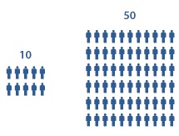
Lupyan & Dale (2010):
Operationalization of contact
= a proxy for language contact
Lupyan, G., & Dale, R. (2010). Language structure is partly determined by social structure.
PloS ONE, 5(1), e8559.

Slide 20
Possible relationships of independent to dependent measure
4. Shared cause
Properties:
Direct causal theory more often difficult to articulate – which can be a clue…
Positing joint cause can help generate new hypotheses about direct causes.
Example:
correlation between population size and grammatical complexity (Lupyan & Dale 2010)
something else
Independent measure
Dependent
measure

Slide 21
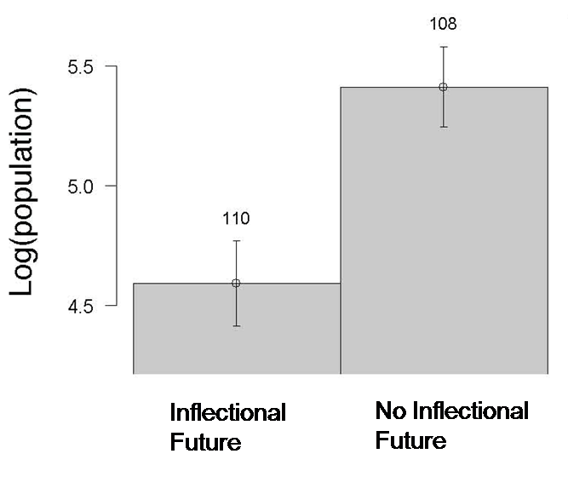
Lupyan & Dale (2010): Results
http://wals.info/feature/67A#2/30.1/148.2
Il fait froid aujourd’hui.
Il fera froid demain.
French
English
Lupyan, G., & Dale, R. (2010). Language structure is partly determined by social structure.
PloS ONE, 5(1), e8559.

Slide 22
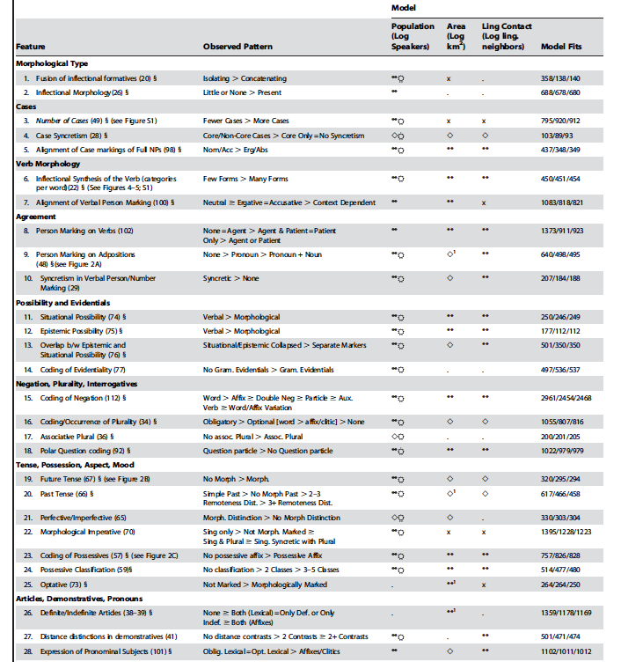
Notes:
26/28 are significantly related to population size … 23 after controlling for language family

Slide 23
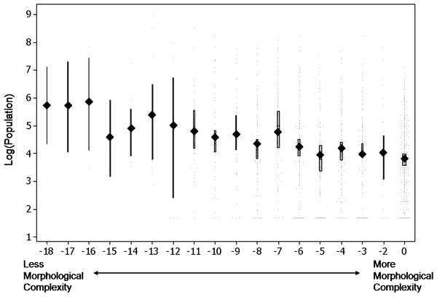
Lupyan & Dale (2010):
An overall complexity score
Lupyan, G., & Dale, R. (2010). Language structure is partly determined by social structure.
PloS ONE, 5(1), e8559.
Notes:
this is a sum score for which they counted in a binary fashion whether a language primarily relied on a lexical or a morphological strategy of encoding… you add up all the ones that are lexical encoded and subtract that from 0… so -18 means that for 18 different features you had 0 of them in the morphology and all of them in the lexicon; 0 means that all of those features are morphologically encoded
what’s an underlying assumption of this? => that all morphologies count equally and you can simply add them up

Slide 24
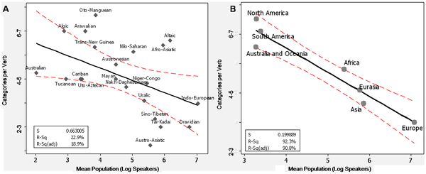
Lupyan & Dale (2010): By-family and by-area results
Lupyan, G., & Dale, R. (2010). Language structure is partly determined by social structure.
PloS ONE, 5(1), e8559.
Notes:
for the six largest language families

Slide 25

Lupyan & Dale (2010): Other ways to operationalize complexity
Sub-result (supplementary materials):
~
compressibility / file reduction ratio correlates with population size!!
Lupyan, G., & Dale, R. (2010). Language structure is partly determined by social structure.
PloS ONE, 5(1), e8559.
Notes:
file reduction ratio

Slide 26
Lupyan & Dale (2010): Other ways to operationalize contact
population size
area
No. of neighboring languages

Slide 27
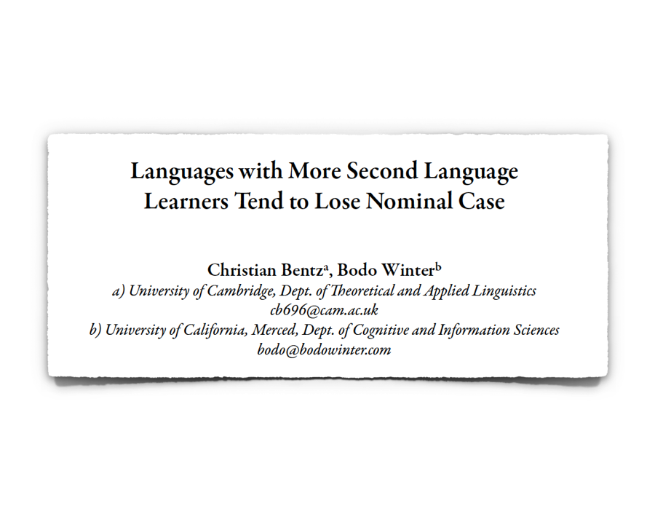

A follow-up: Bentz & Winter (2013)
Christian Bentz
Bentz, C., & Winter, B. (2013). Languages with more second language learners tend to lose nominal case. Language Dynamics & Change, 3:1, 1-27.

Slide 28
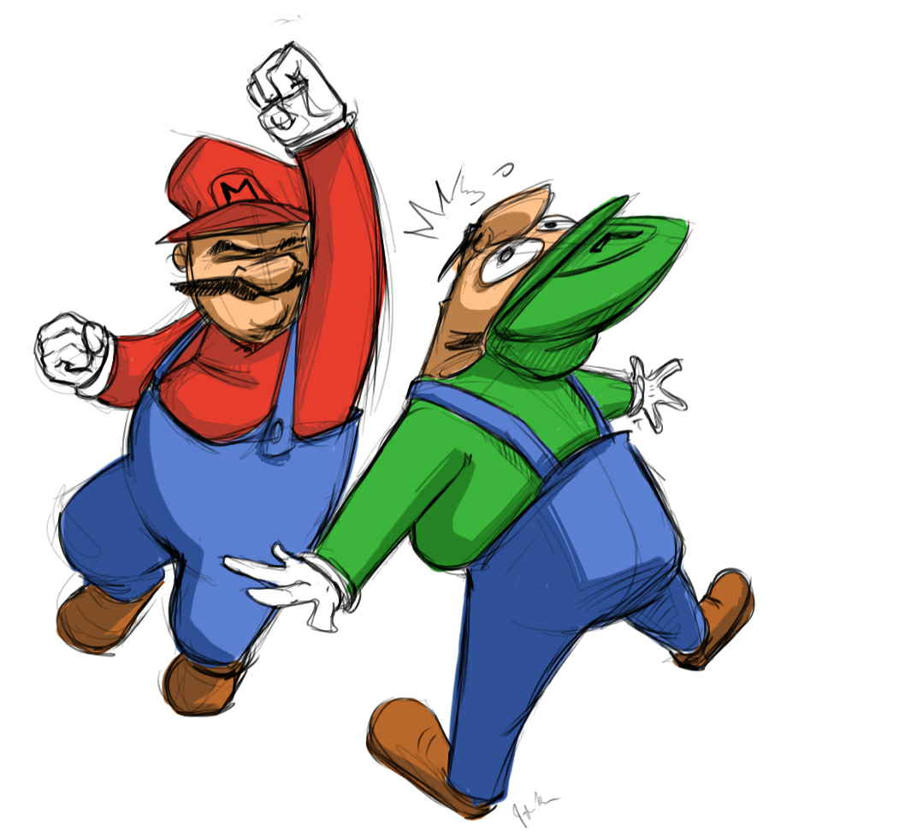
Bentz & Winter (2013): Focus on nominal case
Der Mario hat den Luigi geschlagen.
Nominative
Accusative
Bentz, C., & Winter, B. (2013). Languages with more second language learners tend to lose nominal case. Language Dynamics & Change, 3:1, 1-27.

Slide 29


One potential mechanism: Learning difficulty
Learning Deficits
Imperfect Forms
Parodi et al. (2004); Gürel (2000); Haznedar (2006); Papadopoulou et al. (2011); Jordens et al. (1989)

Slide 30
One potential mechanism: Learning difficulty
Learning Deficits
Imperfect Forms
Parodi et al. (2004); Gürel (2000); Haznedar (2006); Papadopoulou et al. (2011); Jordens et al. (1989)

Slide 31
Bentz & Winter (2013): The sample
2,000+ languages in WALS
231 languages with L2 info
66 languages
… 26 language families
… 16 areas (AUTOTYP)
Iggesen, O. A. (2011). Number of cases. In M. S. Dryer & M. Haspelmath (Eds.),
The World Atlas of Language Structures Online, ch. 49. Munich: Max Planck Digital Library
Notes:
how did we get the data? Ethnologue; censuses; rosetta project
Christian is the one who accumulated this data, had to resort to using the full potentiality of the internet and accumulate data from multiple sources

Slide 32
Bentz & Winter (2013): L2 speaker information
Tamil:
L1: 66,837,600
L2: 8,000,000
L2%: 10.6%
Notes:
there’s other ways of operationalizing this variable that also work, such as using the log of the L2 speaker ratio

Slide 33
Bentz & Winter (2013): Two measures, two analyses
A binary measure
A count measure
Iggesen, O. A. (2011). Number of cases. In M. S. Dryer & M. Haspelmath (Eds.),
The World Atlas of Language Structures Online, ch. 49. Munich: Max Planck Digital Library
Notes:
different ways of coding the data require different analysis
pay attention to what is the most appropriate analysis for a given DV
conceptually the measures are different versions of each other

Slide 34
Bentz & Winter (2013): Two measures, two analyses
A binary measure ➔ Logistic regression
A count measure
Iggesen, O. A. (2011). Number of cases. In M. S. Dryer & M. Haspelmath (Eds.),
The World Atlas of Language Structures Online, ch. 49. Munich: Max Planck Digital Library
Notes:
different ways of coding the data require different analysis
pay attention to what is the most appropriate analysis for a given DV
conceptually the measures are different versions of each other

Slide 35
Bentz & Winter (2013): Two measures, two analyses
A binary measure ➔ Logistic regression
A count measure ➔ Poisson regression
glmer(case ~ L2 + (1+L2|family) + (1+L2|area),family="binomial")
glmer(case ~ L2 + (1+L2|family) + (1+L2|area),family="poisson")
Iggesen, O. A. (2011). Number of cases. In M. S. Dryer & M. Haspelmath (Eds.),
The World Atlas of Language Structures Online, ch. 49. Munich: Max Planck Digital Library
Notes:
different ways of coding the data require different analysis
pay attention to what is the most appropriate analysis for a given DV
conceptually the measures are different versions of each other

Slide 36
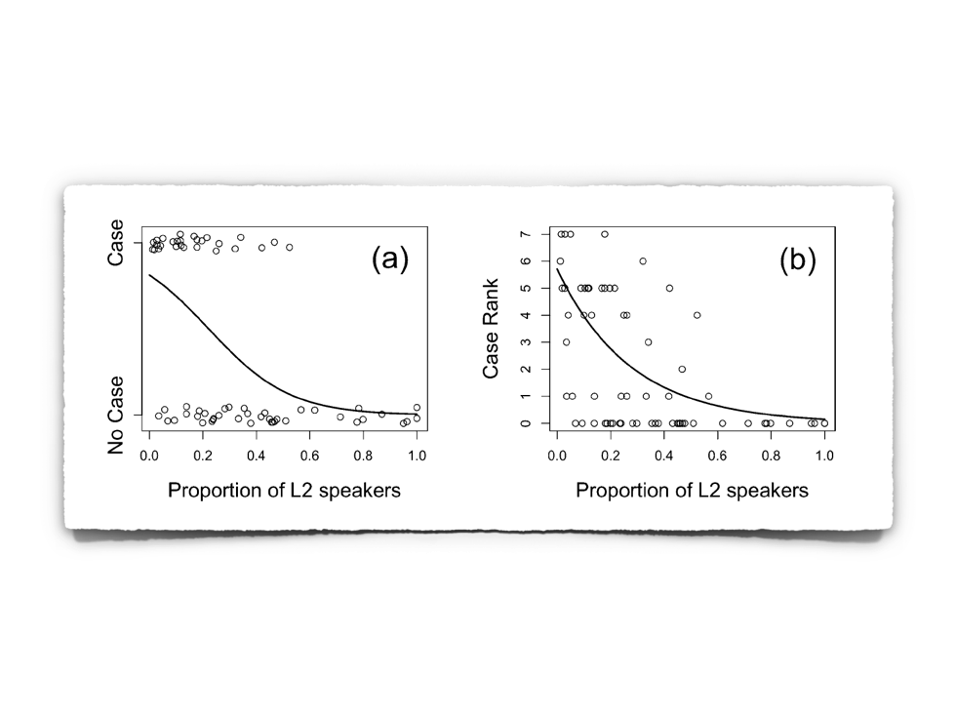
Bentz & Winter (2013): Results
Iggesen, O. A. (2011). Number of cases. In M. S. Dryer & M. Haspelmath (Eds.),
The World Atlas of Language Structures Online, ch. 49. Munich: Max Planck Digital Library

Slide 37
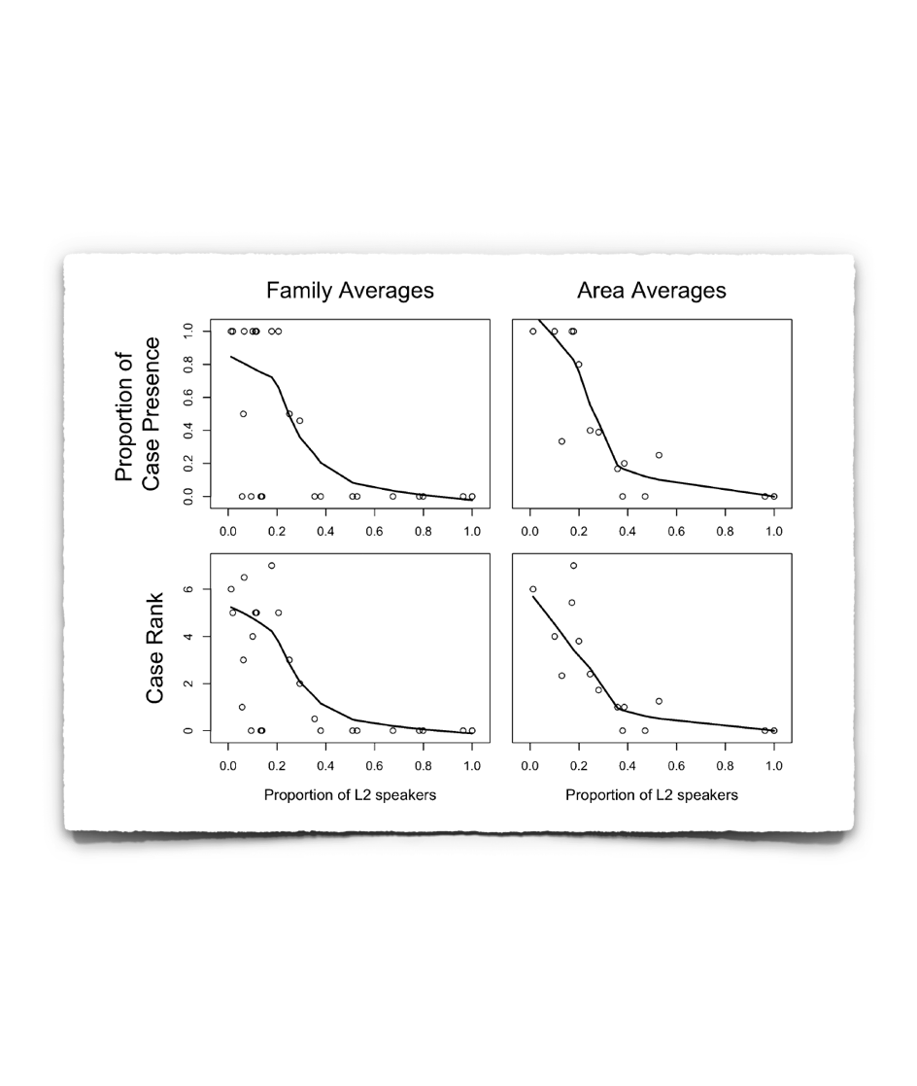
Bentz & Winter (2013): Results
Iggesen, O. A. (2011). Number of cases. In M. S. Dryer & M. Haspelmath (Eds.),
The World Atlas of Language Structures Online, ch. 49. Munich: Max Planck Digital Library

Slide 38
Bentz & Winter (2013): Robustness of the results
Excluding Indo-European languages
✔
Excluding languages with no historical case
✔
Language-by-language deletion
✔
Iggesen, O. A. (2011). Number of cases. In M. S. Dryer & M. Haspelmath (Eds.),
The World Atlas of Language Structures Online, ch. 49. Munich: Max Planck Digital Library

Slide 39
Bentz & Winter (2013): In the small sample, language does not correlate with population size
✗
~
Iggesen, O. A. (2011). Number of cases. In M. S. Dryer & M. Haspelmath (Eds.),
The World Atlas of Language Structures Online, ch. 49. Munich: Max Planck Digital Library

Slide 40
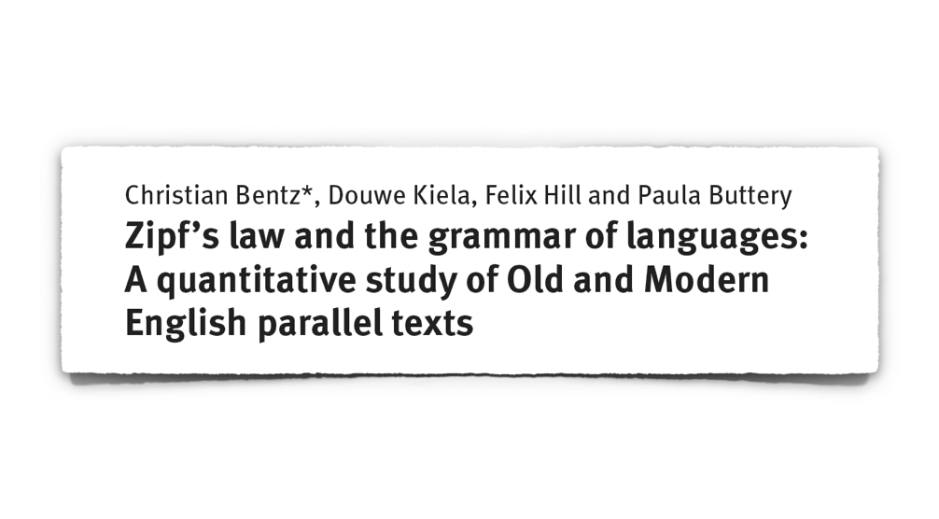
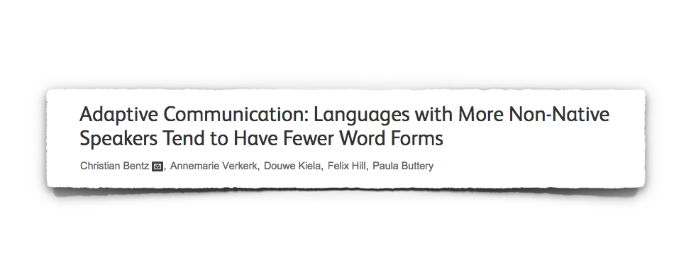
More follow-ups!
Christian Bentz

Slide 41
More follow-ups!
Christian Bentz

Slide 42
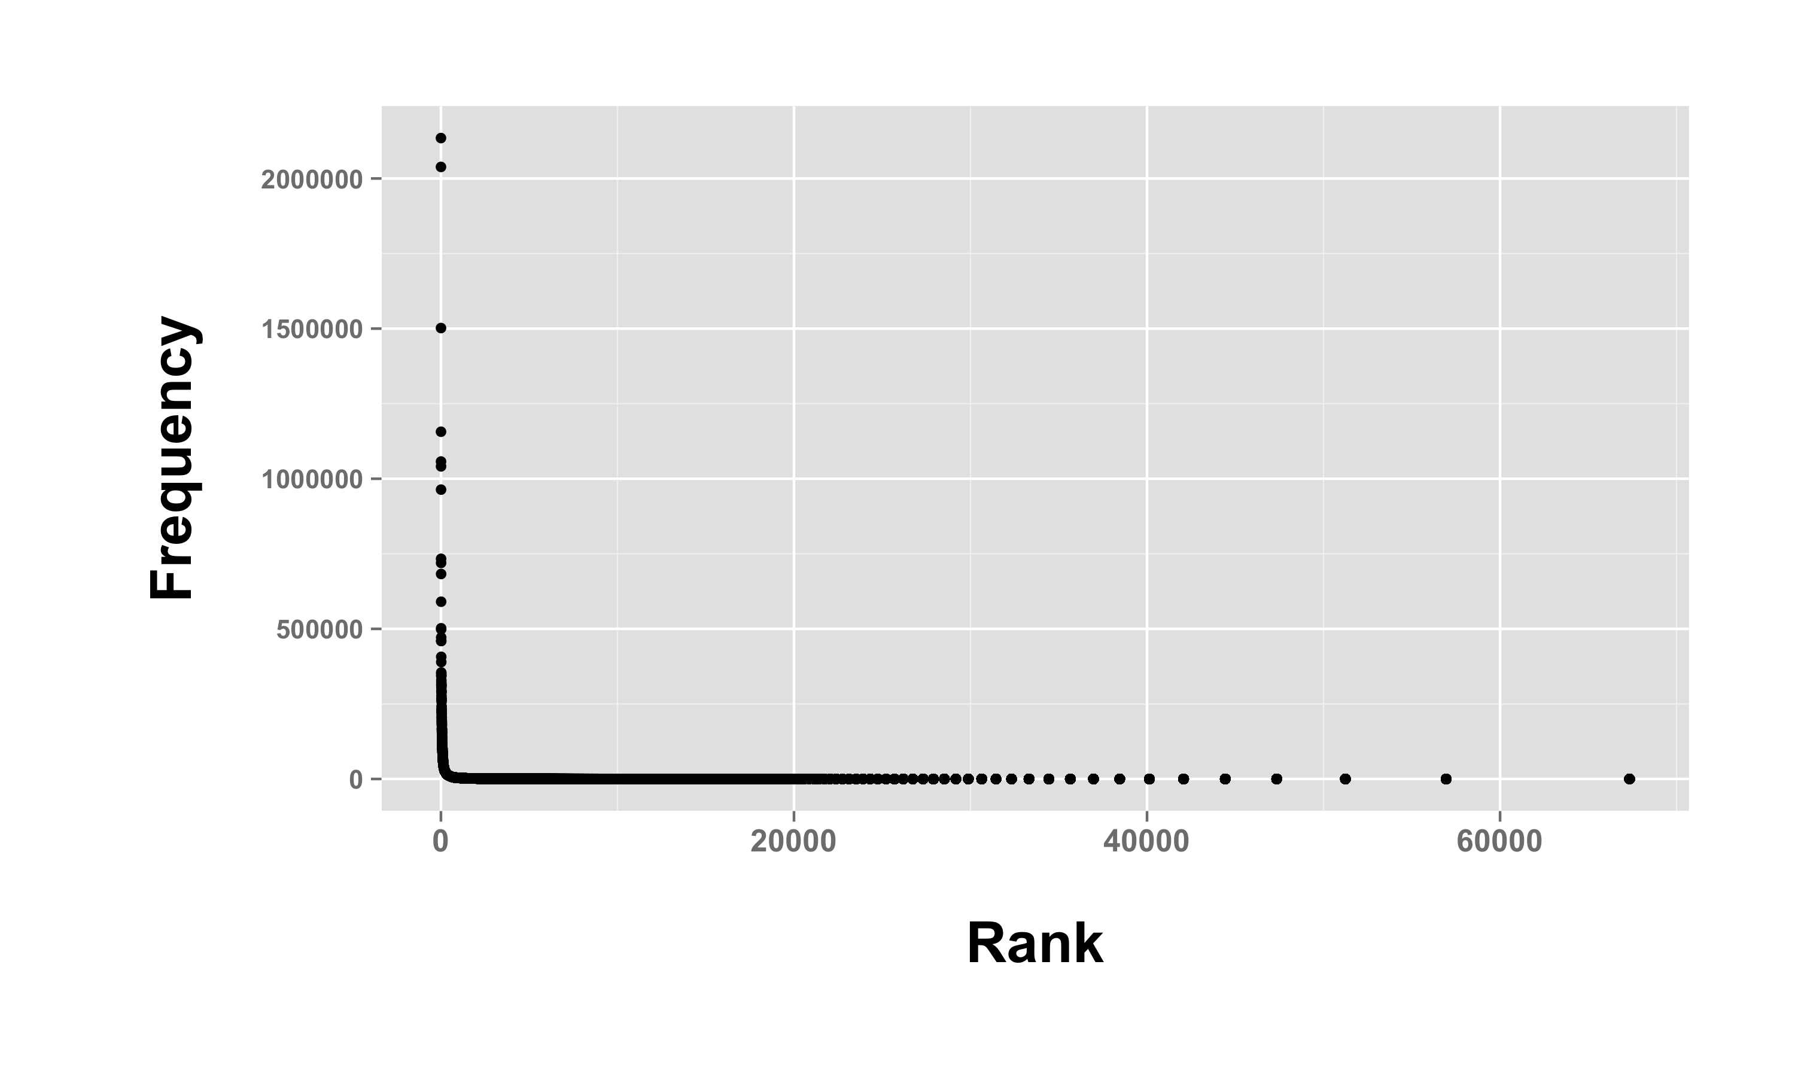
Background: Zipf’s law

Slide 43
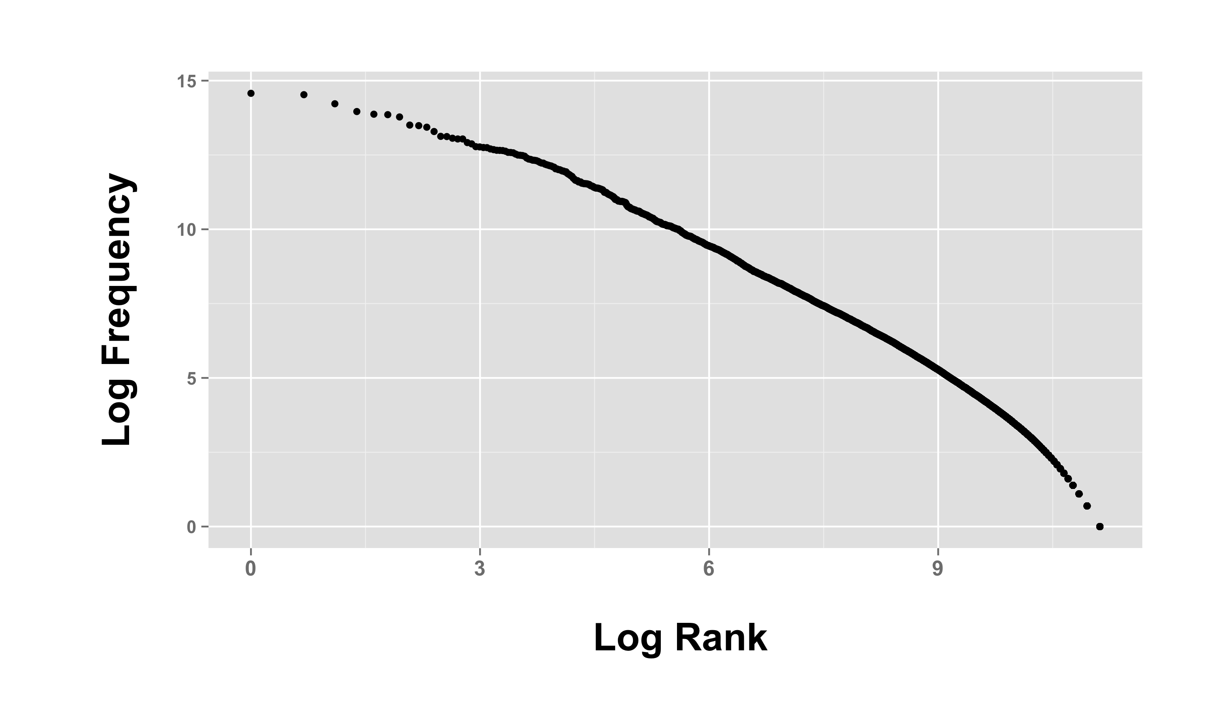
Background: Zipf’s law
Notes:
bigger alpha

Slide 44
Bentz et al. (2014):
Basic idea
Old English
Modern English
(500-1100 CE)
Notes:
we basically already know what is going to happen since there’s already tons of work on this, but they’re going to do some cool new ways of getting the same results
and as we’ll see once this works for other languages
proof of concept for a case that we know well; calibration with something that is undisputed; calibrating the method
Old English traded Old English morphologically marked content words (e.g., case) for perephrastic constructions
and it also lost things like the subjunctive and replaced it with auxiliaries

Slide 45
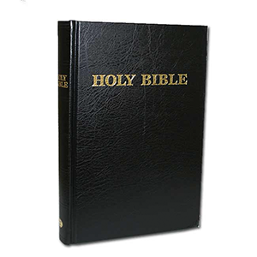
Bentz et al. (2014):
Basic idea
land
landes
land
lande
Old English
Modern English
(500-1100 CE)
Notes:
a way to think about this is that land/landes/lande share the frequency space… and once they’re all the same, land is going to become more frequent, and there are less forms that are less frequent; pull the whole tail of this distribution in

Slide 46
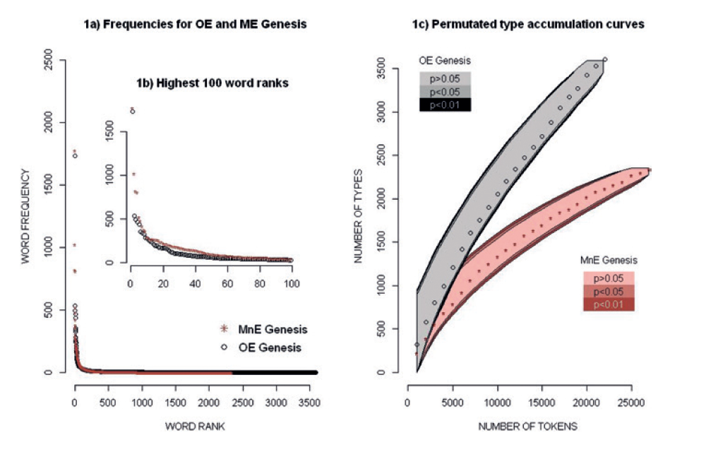
Bentz et al. (2014):
Results
Bentz, C., Kiela, D., Hill, F., & Buttery, P. (2014). Zipf's law and the grammar of languages: A quantitative study of Old and Modern English parallel texts. Corpus Linguistics and Linguistic Theory, 10(2), 175-211.
Notes:
Modern English has a about 1,000 hapax legomena less than Old English!!!!

Slide 47
Is this due to morphology?
Beware of spelling variants!!
gatu ~ ġeatu ‘gates’
gladian ~ gleadian ‘gladden’
maniġ ~ moniġ ‘many’
medo ~ meodo ‘mead’
werod ~ weorod ‘troop’
self ~ sylf ‘self’
sellan ~ syllan ‘give’
https://wmich.edu/medieval/resources/IOE/variants.html
Notes:
it’s always a good question to ask yourself: how could I fool myself?
really good work brainstorms as long as possible; what other things could be going on and how could I control for this

Slide 48
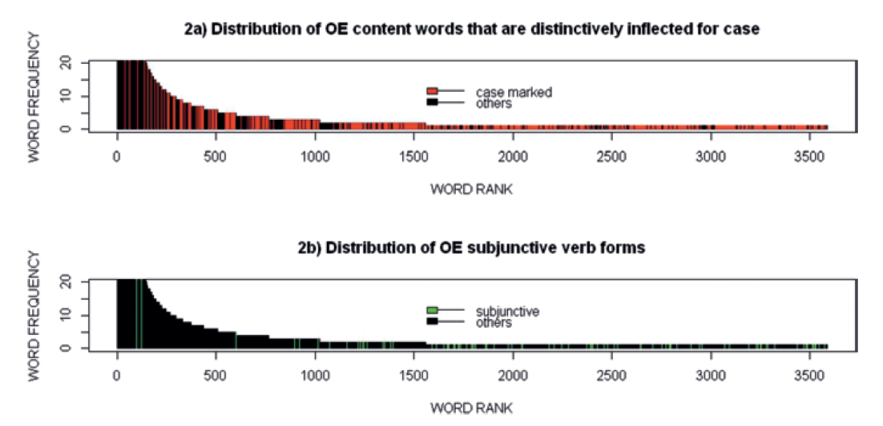
Bentz et al. (2014):
Results by case and subjunctive
Bentz, C., Kiela, D., Hill, F., & Buttery, P. (2014). Zipf's law and the grammar of languages: A quantitative study of Old and Modern English parallel texts. Corpus Linguistics and Linguistic Theory, 10(2), 175-211.
Notes:
They say that half of the hapax legomena of Old English are case-marked!!

Slide 49
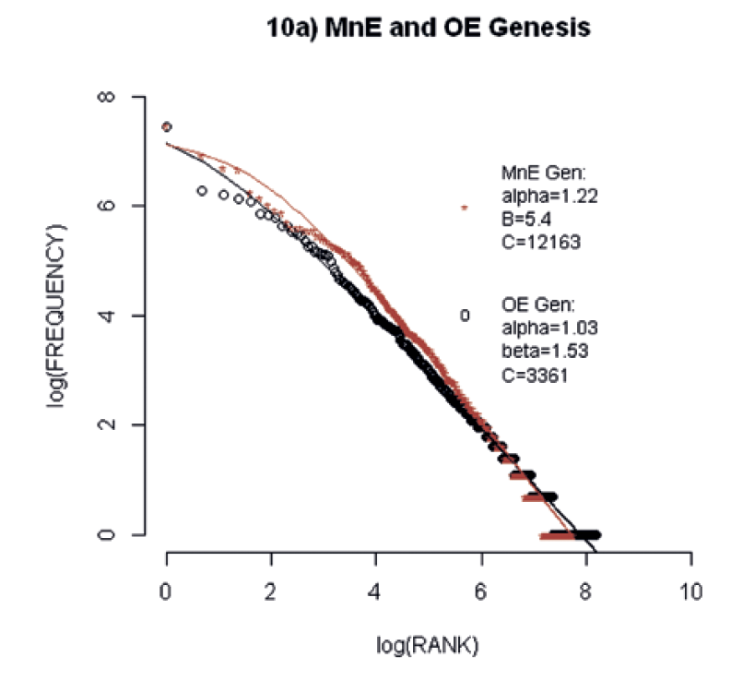
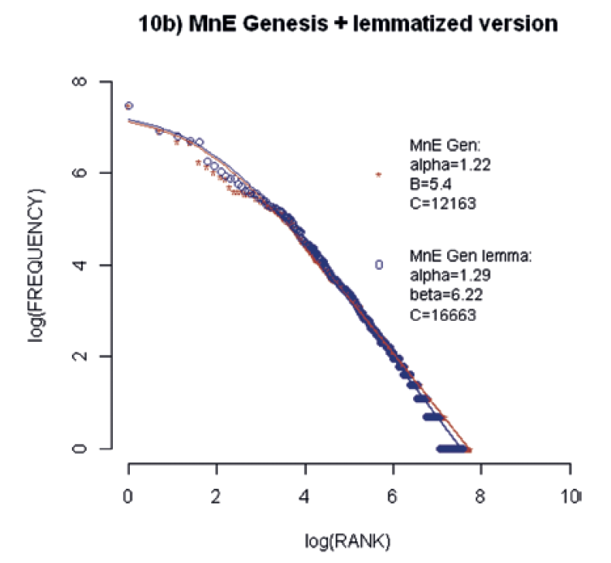
Bentz et al. (2014):
Lemmatizing Old English
Bentz, C., Kiela, D., Hill, F., & Buttery, P. (2014). Zipf's law and the grammar of languages: A quantitative study of Old and Modern English parallel texts. Corpus Linguistics and Linguistic Theory, 10(2), 175-211.
Notes:
LEMMATIZING: if we are on the right track; this should happen… a good way to check
the red line, middle English, remember, has less hapax legomena… so, it ends earlier and needs to have a steeper slow, pulling a low
higher beta value means that for high frequency values, the modern english curve deviates more

Slide 50
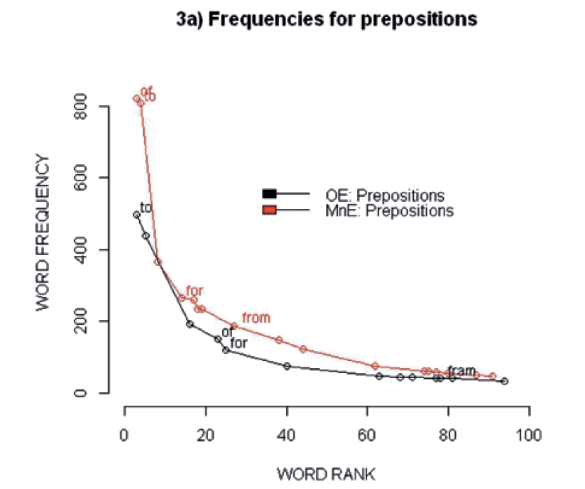
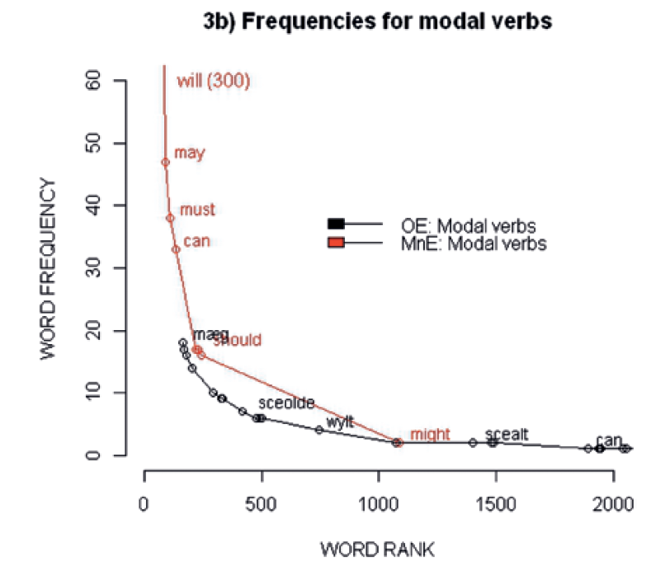
Bentz et al. (2014): Syntagmatic ~ paradigmatic trade-off
Bentz, C., Kiela, D., Hill, F., & Buttery, P. (2014). Zipf's law and the grammar of languages: A quantitative study of Old and Modern English parallel texts. Corpus Linguistics and Linguistic Theory, 10(2), 175-211.
Notes:
two encoding strategies

Slide 51
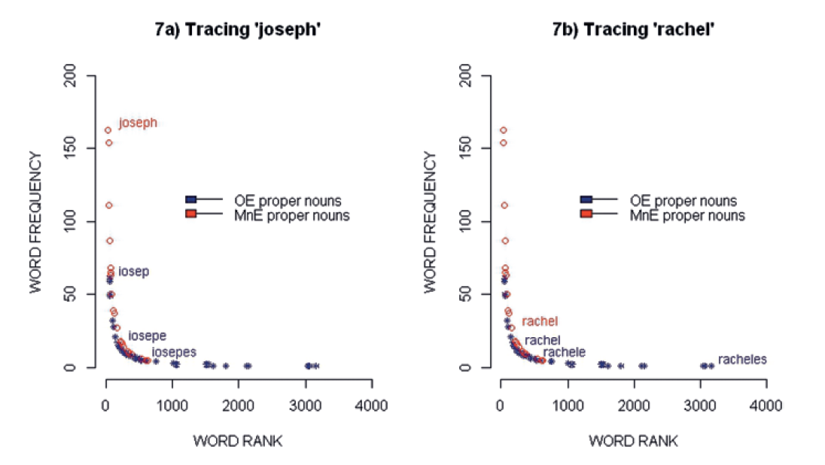
Proper names to control for spelling variants
Bentz, C., Kiela, D., Hill, F., & Buttery, P. (2014). Zipf's law and the grammar of languages: A quantitative study of Old and Modern English parallel texts. Corpus Linguistics and Linguistic Theory, 10(2), 175-211.

Slide 52
More follow-ups!
Christian Bentz

Slide 53
More follow-ups!
Christian Bentz

Slide 54

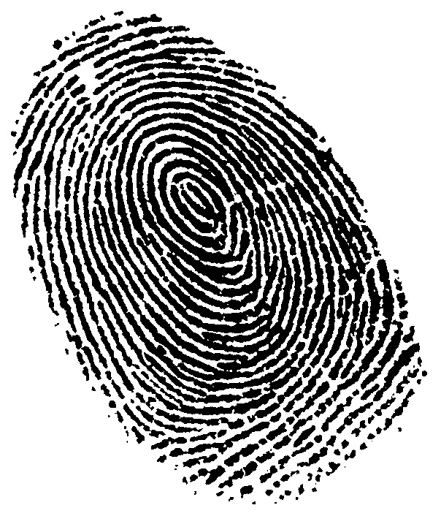
Zipf’s idea
“positional”
vs. “inflected”
“Grammatical Fingerprint”
Bentz, C., Verkerk, A., Kiela, D., Hill, F., & Buttery, P. (2015). Adaptive communication: Languages with more non-native speakers tend to have fewer word forms. PLoS ONE 10(6): e0128254.

Slide 55
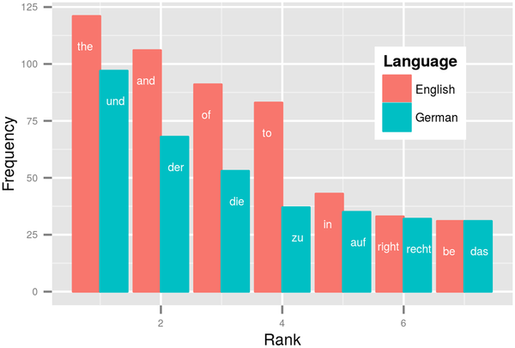
Zipf’s idea: Bentz et al. (2015)
Bentz, C., Verkerk, A., Kiela, D., Hill, F., & Buttery, P. (2015). Adaptive communication: Languages with more non-native speakers tend to have fewer word forms. PLoS ONE 10(6): e0128254.

Slide 56
Bentz et al. (2015):
Three measures of lexical diversity
(1) Zipf-Mandelbrot
(2) Shannon entropy
(3) Type-token ratio
Bentz, C., Verkerk, A., Kiela, D., Hill, F., & Buttery, P. (2015). Adaptive communication: Languages with more non-native speakers tend to have fewer word forms. PLoS ONE 10(6): e0128254.

Slide 57
Bentz et al. (2015):
Three measures of lexical diversity
(1) Zipf-Mandelbrot
(2)
(3) Type-token ratio
Bentz, C., Verkerk, A., Kiela, D., Hill, F., & Buttery, P. (2015). Adaptive communication: Languages with more non-native speakers tend to have fewer word forms. PLoS ONE 10(6): e0128254.
Notes:
uncertainty when drawing words randomly from a text… in English, for example, it is not as uncertain, about 20% of the time you’ll get “the”
German, which has grammatical gender marking in the articles “der, die, das” will have a higher uncertainty

Slide 58
Bentz et al. (2015):
Three measures of lexical diversity
(1) Zipf-Mandelbrot
(2)
(3) Type-token ratio
➔ Bonferroni correction (YEAH!)
Bentz, C., Verkerk, A., Kiela, D., Hill, F., & Buttery, P. (2015). Adaptive communication: Languages with more non-native speakers tend to have fewer word forms. PLoS ONE 10(6): e0128254.
Notes:
this might be the weakest measure of lexical diversity since it has been shown to depend on text size

Slide 59
Bentz et al. (2015):
Three sources
(1) Universal Declaration of Human Rights
N=400, ~2,000 words per language
(2) Parallel Bible Corpus
N=800, ~20,000 words per language
(3) Europarl Parallel Corpus
N=21, ~7 million words per language, European only
83 families, 182 genera
Bentz, C., Verkerk, A., Kiela, D., Hill, F., & Buttery, P. (2015). Adaptive communication: Languages with more non-native speakers tend to have fewer word forms. PLoS ONE 10(6): e0128254.
Notes:
Constant information content!!!
they defined word types as things that are separated by spaces!!! (not a linguistically deep definition, but pretty much all of what computational linguistics can do)

Slide 60
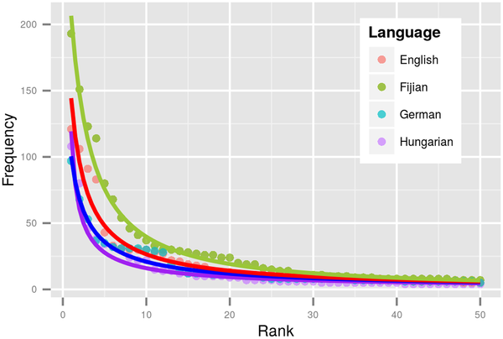
lower diversity = higher C, α and β
Bentz, C., Verkerk, A., Kiela, D., Hill, F., & Buttery, P. (2015). Adaptive communication: Languages with more non-native speakers tend to have fewer word forms. PLoS ONE 10(6): e0128254.
Notes:
ranks for the fifty highest frequency words
more diverse languages have more hapax legomena as well : Hungarian > German > English > Fijian

Slide 61
Bentz et al. (2015):
Three statistical approaches
(1) Linear regression
(2) Linear mixed effects regression
(3) Phylogenetic least squares regression
Bentz, C., Verkerk, A., Kiela, D., Hill, F., & Buttery, P. (2015). Adaptive communication: Languages with more non-native speakers tend to have fewer word forms. PLoS ONE 10(6): e0128254.
Notes:
different questions: (2) across language families and areas, (3) within language families… (3) only on Indo-European
Phylognetic least squares asks to what extent the L2~lexical diversity measure differs WITHIN language families; but it needs (1) lots of languages from the same family and (2) published tree data

Slide 62
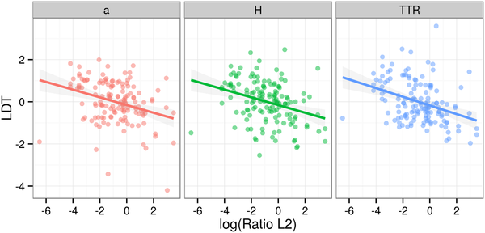
Bentz et al. (2015):
Results for the three measures
R²=0.11
Bentz, C., Verkerk, A., Kiela, D., Hill, F., & Buttery, P. (2015). Adaptive communication: Languages with more non-native speakers tend to have fewer word forms. PLoS ONE 10(6): e0128254.

Slide 63
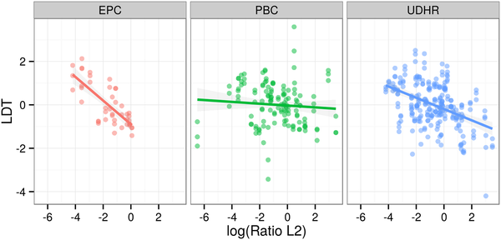
Bentz et al. (2015):
Results for the three corpora
Bentz, C., Verkerk, A., Kiela, D., Hill, F., & Buttery, P. (2015). Adaptive communication: Languages with more non-native speakers tend to have fewer word forms. PLoS ONE 10(6): e0128254.

Slide 64
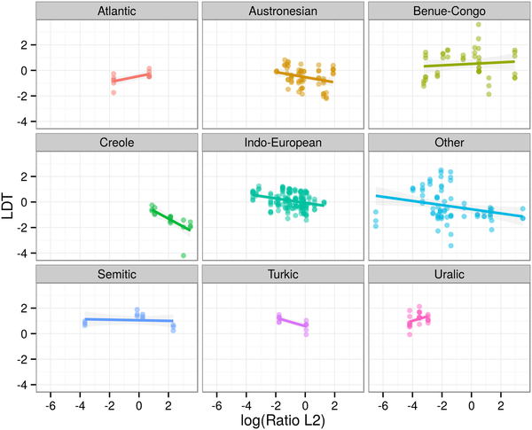
Language families
Bentz, C., Verkerk, A., Kiela, D., Hill, F., & Buttery, P. (2015). Adaptive communication: Languages with more non-native speakers tend to have fewer word forms. PLoS ONE 10(6): e0128254.

Slide 65
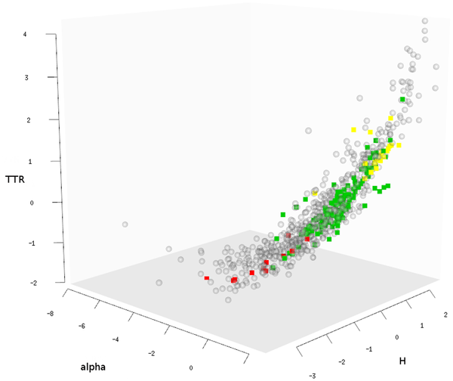
A lexical diversity space of human languages
Bentz, C., Verkerk, A., Kiela, D., Hill, F., & Buttery, P. (2015). Adaptive communication: Languages with more non-native speakers tend to have fewer word forms. PLoS ONE 10(6): e0128254.
Notes:
lexical diversity space, according to these three measures
yellow squares = Altaic
green = Indo-European
Creole languages = red
BETWEEN FAMILY VARIATION

Slide 66
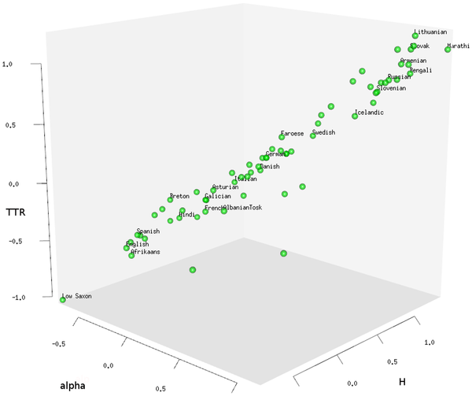
Indo-European lexical diversity
Bentz, C., Verkerk, A., Kiela, D., Hill, F., & Buttery, P. (2015). Adaptive communication: Languages with more non-native speakers tend to have fewer word forms. PLoS ONE 10(6): e0128254.
Notes:
low saxon extreme low; marathi and lithuanian top right

Slide 67
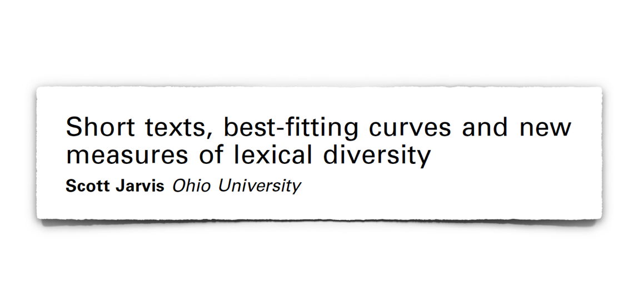
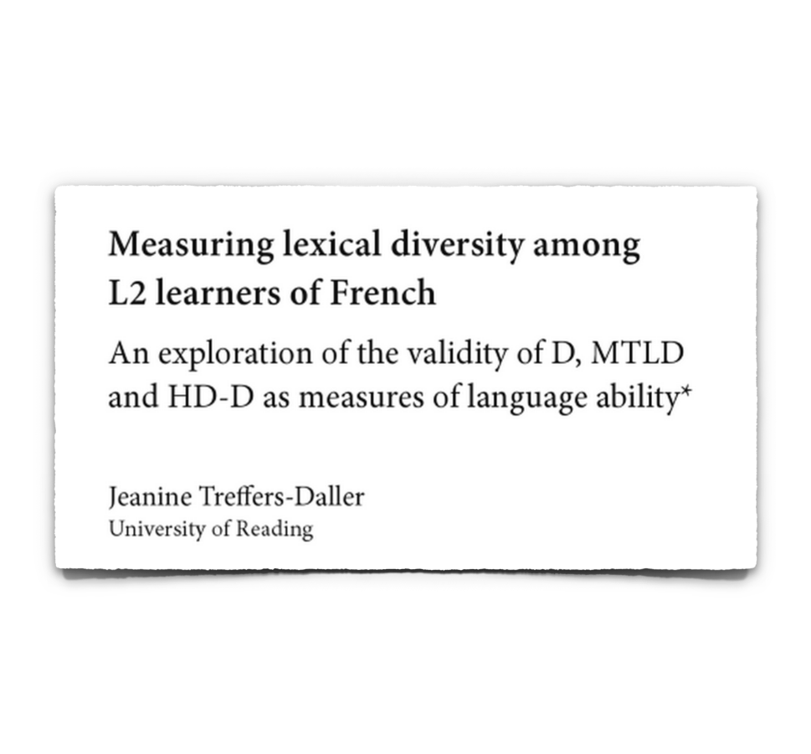
Lexical diversity and L2 speakers
Bentz, C., Verkerk, A., Kiela, D., Hill, F., & Buttery, P. (2015). Adaptive communication: Languages with more non-native speakers tend to have fewer word forms. PLoS ONE 10(6): e0128254.

Slide 68
Nettle (2012): mechanisms of morphological reduction
Adult learning difficulty (Lupyan & Dale, 2010; Bentz & Winter, 2013)
Heterogeneous learner input & phonological erosion (Nettle, 2012: 1833)
Foreigner Talk
(e.g., Little, 2011)
Borrowing
(e.g., discussed in Barðdal & Kulikov, 2009)
Neutral change & fixation to suboptimal strategies? (Nettle, 1999)
Nettle, D. (1999). Is the rate of linguistic change constant? Lingua, 108, 119–136.
Nettle, D. (2012). Social scale and structural complexity in human languages. Philosophical Transactions of the Royal Society B: Biological Sciences, 367(1597), 1829-1836.
Notes:
it’s the same family of explanations; the L2 learners are producing something incorrectly…
these are not MUTUALLY EXCLUSIVE
language-internal factors… we don’t want to say
Andy had some really good ideas about there being additional population internal factors

Slide 69
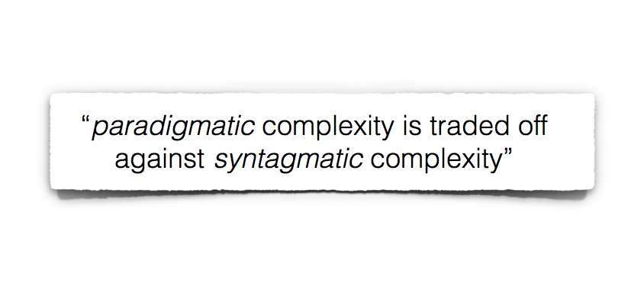
Nettle (2012): paradigmatic ~ syntagmatic trade-off
Nettle (2012: 1830)
Nettle, D. (2012). Social scale and structural complexity in human languages. Philosophical Transactions of the Royal Society B: Biological Sciences, 367(1597), 1829-1836.

Slide 70
Nettle (2012): morphology and phonology across languages
Morphology
popsize ➔ -paradigmatic, +syntagmatic
Phonology
popsize ➔ +paradigmatic, -syntagmatic
Nettle, D. (2012). Social scale and structural complexity in human languages. Philosophical Transactions of the Royal Society B: Biological Sciences, 367(1597), 1829-1836.
Notes:
morphology: word tokens are correlated with word forms… so the more distinct forms you have (morphologically inflected), the less word tokens you need; languages like English that are very analytical have a lot of word tokens… this has been shown for parallel texts where the information is constant

Slide 71
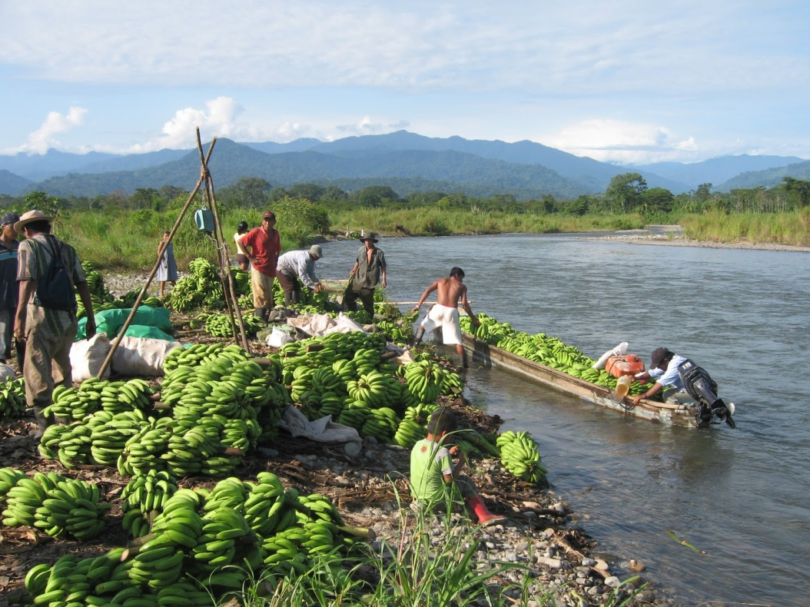
Symmetrical contact and its correlation with
morphological complexity in endangered languages
Rolando Coto-Solano. LSA 89th Annual Meeting. Portland, January 2015

Slide 72
Introduction: Different kinds of contact
Large (exoteric) languages have assymetric contact with their neighbors. People entering large societies have to learn the majority language, but the majority speakers don't learn the minority languages (Dahl 2004).
However, small (esoteric) languages have more symmetric contacts, so that children learn both languages and L1 multilingualism is the norm in these societies (Trudgill 2011, Nettle & Romaine 2000, Aikhenvald 2002, Sasse 1992, Bowern 2010).
What happens to the correlation between complexity and social factors such as population and number of neighbors when only these minority languages are considered? This is the objective of this presentation.

Slide 73
Andy rephrases:
Hypothesis: L1 – L1 language contact can result in an increase in complexity
Test: for small languages, is number of other close small languages positively correlated with complexity?

Slide 74
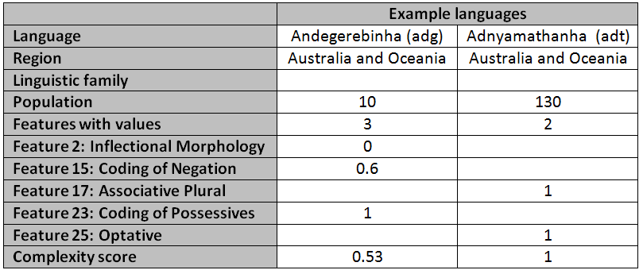
Methodology: Complexity
Following (L&D), 28 morphological features were extracted from the WALS database (Dryer & Haspelmath 2011) and normalized according to the complexity scores proposed by the authors. Each feature had a score ranging from 0 to 1. The average of these is the complexity for a language.

Slide 75
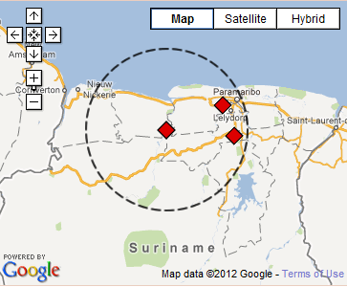
Methodology: Social factors
Population counts and endangerment status were obtained from the UNESCO Atlas of World's Languages in Danger (Moseley 2010). Neighbor counts were obtained from WALS. The "neighbors" are the number of languages whose geographic locus is located within 100 km of a given language.
E.g.: Carib (Cariban; Northern Suriname) and its neighbors. Carib is at the center of the circle. Its two neighbors are Sranan (upper) and Arawak (lower). The circle represents a radius of 100 km. around the locus of Carib. (Source: WALS)

Slide 76
Methodology: Statistical models
Languages with less than 5 morphological features were excluded, and the final dataset included 220 languages. The population and number of neighboring languages were transformed with a square root to address normality issues.

Slide 77
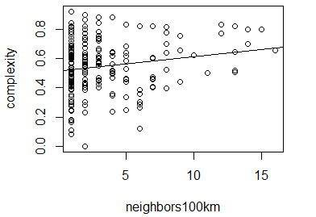
Results
There was no interaction between population and number of neighbors (p=0.4). Neither was there a main effect of population (p=0.5).
There was a small (R² = 0.021) but significant (t(217)=2.1, p < 0.05) correlation between neighbors and complexity.

Slide 78
Results
The relationship remains significant after it's controlled for region and linguistic family:
Model 1:
complexity ~ neighbors100km + (1|family) + (1|Region)
(χ²(1)=7.51, p < 0.01, AIC= -149.2)
(Used neighbors100km as random slope on family and region as well -> same result)

Slide 79
Discussion
The model has implications in the following areas:
Geography and languages
Human geography and languages
Language and Natural Systems

Slide 80
Discussion: Geography
Geography leaves its mark on the complexity values. Of the languages with the lowest fitted values, seven are on islands, which might contribute to their isolation and reduced complexity.
Name Fitted value Location
Nicobarese 0.36 Nicobar/Andaman
Remo 0.39 Isolated hills of Odisha, India
Mon 0.39 Lowland Burma
Chrau 0.39 Dong Nai province, Vietnam
Urak Lawoi' 0.39 Adang Archipelago, Thailand
Chamorro 0.40 Mariana Islands
Mokilese 0.40 Mokil Atoll, Micronesia
Puluwat 0.40 Coral Atoll, Micronesia
Ulithian 0.40 Ulithi Atoll, Micronesia
Kosraean 0.40 Lelu Island, Micronesia

Slide 81
Discussion: Geography
On the other hand, of the languages with the highest fitted values, seven are near rivers, which might serve as ways of communication with other communities and help increase complexity.
Name Fitted value Location
Malakmalak 0.66 Daly River, Northern Territory, Australia
Shuswap 0.66 Fraser River and Rocky Mountains, BC
Sarcee 0.66 Calgary, Alberta, Canada
Tanacross 0.66 Goodpaster, Tortymile and Tok rivers, AL
Tlingit 0.66 Cooper River, Gulf of Alaska
Dumi 0.68 Between two rivers in Khotang, Nepal
Dargwa 0.68 Dagestan, Russia (Caucasus)
Tsez 0.68 Dagestan, Russia (Caucasus)
Desano 0.68 Tiquié River, Colombia and Brazil
Tsova-Tush 0.69 Ts'ova Gorge and Alazani River, Georgia

Slide 82
Introduction: Linguistic Niche Hypothesis
An esoteric niche, one associated with higher complexity, is one with "less population, smaller area, fewer linguistic neighbors".
This is exactly the niche of an Indigenous/Aboriginal/Native language, but in those languages we don't see complexity, we see loss of morphological patterns and simplification (Campbell & Muntzel, 1992, Hale, Krauss et.al., Tsunoda 2005, Romaine 1989, Fishman 1991, UNESCO 2003, Crystal 2000).

Slide 83

Conclusions: Language Niche revisited
These results suggest that the features of the Linguistic Niche hypothesis should be reexamined. It might be the case that the quality of language contact is one separating factor between a minority language and an endangered language.
symmetrical
symmetrical

Slide 84

Conclusions
It's not only about quantity of contact: It's also about quality of contact.

